Slide 1
Comic Strip Analysis and Design
Inheritance, Abstract Classes, and Polymorphism part1
Barb Ericson
Georgia Institute of Technology
May 2006

Slide 2
Learning Goals
Do an analysis for a comic strip
Do a design for a comic strip
Pull out a common parent class
  Generalization
Give an example of an abstract class
Extend a parent class, but do something differently
  Specialization
Understand polymorphism
  And how run-time or dynamic binding works

Slide 3
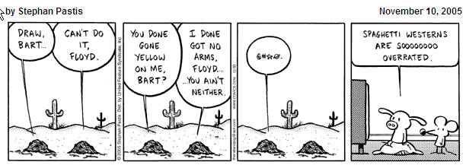
What do we mean by a comic strip?
What parts does it have?
What things should you be able to find out about one?
Notes:
See http://en.wikipedia.org/wiki/Comic_strip for a definition.

Slide 4
A Comic Strip
Has a name and an author
Typically has 4 panels, but can have more or less
The Comic Strip: Pears Before Swine

Slide 5
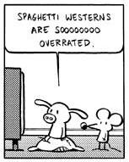
A Comic Panel
Has a picture
And one or more speech balloons

Slide 6
When to Use Inheritance?
Should a comic panel have a picture as a field or inherit from picture?
It depends if they are both kind of pictures
Does it make sense to use a comic panel anytime you would use a picture?
A child inherits all the fields and methods of the parent class
  So don't use inheritance if you just want access to some methods and/or fields
  If you aren't sure use a field instead of inheritance

Slide 7
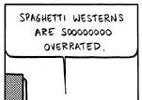
A Speech Balloon
Is a rounded rectangle or ellipse with text (words) in it
Has a tail that indicates who is speaking
  The tail is shown as a triangle from the bottom of the rounded rectangle to the speaker
Notes:
Speech balloons are also called speech bubbles.

Slide 8
A UML Class Diagram
Shows the design for an object-oriented solution
  Shows each class as a rectangular box
    May include the fields and methods
  Shows the relationships between objects of the classes
    Has a (association)
    Is a (inheritance)
ComicStrip
author
name
1*
ComicPanel
1
0*
Picture
SpeechBalloon
upperLeft
tailEnd
message
Notes:
A ComicStrip object has one or more ComicPanel objects associated with it. Each ComicPanel object has 1 Picture object and 0 to many SpeechBalloon Objects. Each box is a class. The class name is at the top of the box. Following the class name and after a line are the fields (data).

Slide 9
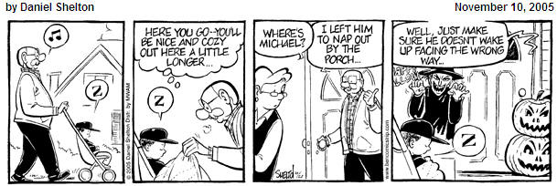
Thought Balloons
Are like speech balloons
  But they show what a character is thinking, not saying
  Use circles to connect balloon to thinker
The Comic Strip: Ben

Slide 10
How to Handle Thought Balloons?
We could copy the class for speech balloon and save it out with a new name
  And change everywhere that has Speech to Thought
  But what if we later want to add something to both classes?
    We would have to add it in both classes
  Also, how would we handle the ComicPanel?
    Would it have 0 or more SpeechBalloons and 0 or more ThoughtBalloons?

Slide 11
How to Handle Thought Balloons?
We could make a new class ThoughtBalloon
  As a subclass of SpeechBalloon
    Since they are very similar
    But, is this right?
      Is a ThoughtBalloon a kind of SpeechBalloon?
ComicStrip
author
name
1*
ComicPanel
1
0*
Picture
SpeechBalloon
upperLeft
tailEnd
message
ThoughtBalloon

Slide 12
Be Careful with Inheritance!
Only use it when the child is really of the same type of thing as the parent
  Not just to reuse similarities
Instead pull out a common parent class
  And have both SpeechBalloon and ThoughtBalloon inherit from it
    Pull out all common fields and methods
      And put them in the common parent class
This is also called generalization

Slide 13
Generalization
Move common fields and methods into a parent class
  And let the children classes inherit the fields and methods
  Easier to maintain than copying fields and methods
  Better than using inheritance when the child isn’t really a kind of parent
  Makes it easier to add new children classes
ComicStrip
author
name
1*
ComicPanel
1
0*
Picture
TextBalloon
upperLeft
tailEnd
message
SpeechBalloon
ThoughtBalloon
Notes:
Now we read the UML class diagram as a ComicStrip object has 1 or more ComicPanel objects associated with it. Each ComicPanel object has 1 Picture object and 0 to many TextBalloon objects. A SpeechBalloon is a kind of TextBalloon and a ThoughtBalloon is another kind of TextBalloon. SpeechBalloon and TextBalloon are subclasses or children classes of TextBalloon. TextBalloon is a parent or superclass to SpeechBalloon and ThoughtBalloon.

Slide 14
TextBalloons
What should a text balloon know how to do?
  It should know how to draw itself
    It will need a graphics context
      Used to do the drawing
Add the draw method to the UML class diagram
TextBalloon
upperLeft
tailEnd
Message
draw(Graphics g)

Slide 15
Abstract Class
Can we draw just a text balloon?
  What would we draw?
    We could draw the balloon and text
    What kind of tail would it have?
We need to know what type of text balloon it is in order to draw the tail
  Which we will only know at run-time
    Can’t predict what will be needed
So TextBalloon is an abstract class
  One that you can not create an object from
  You can only inherit from it
  And it will have an abstract method drawTail
    Subclasses will override draw or also be abstract

Slide 16
Try it
Try to create a TextBalloon object using the interactions pane in DrJava
  Use the constructor that takes a upper left point (java.awt.Point), a width, the point of the tail (java.awt.Point) and a string.
  import java.awt.Point;
  TextBalloon balloon = new TextBalloon(new Point (23,33),100,new Point(50,40),”Hi”);
What error do you get?

Slide 17
How to Create an Abstract Class
Add the keyword abstract to the class definition
  public abstract class TextBalloon
Abstract classes often have abstract methods
  To create an abstract method add the keyword abstract to the method definition
    and end the method with a semicolon after the parameter list
  public abstract void drawTail(paramList);

Slide 18

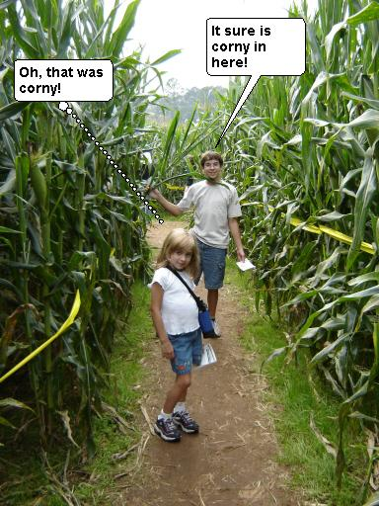
Exercise
Run the main method in ComicPanel to see an example with both a speech balloon and a thought balloon
Modify the main method to create your own comic panel with a speech balloon and a thought balloon
Notes:
You can do this on any picture. You can use the picture explorer to figure out the point to use for the upper left of the text balloon and the tail end of the tail.

